Slide 1
Graph QL
May 30,2023
Finla N A
245242

Slide 2
What is GraphQL?
GraphQL is an open-source query language and runtime for APIs.
Developed by Facebook in 2015.
Provides a more efficient and flexible alternative to traditional RESTful APIs.
Enables declarative datafetching.
GraphQL server exposes single endpoint and responds to queries.

Slide 3
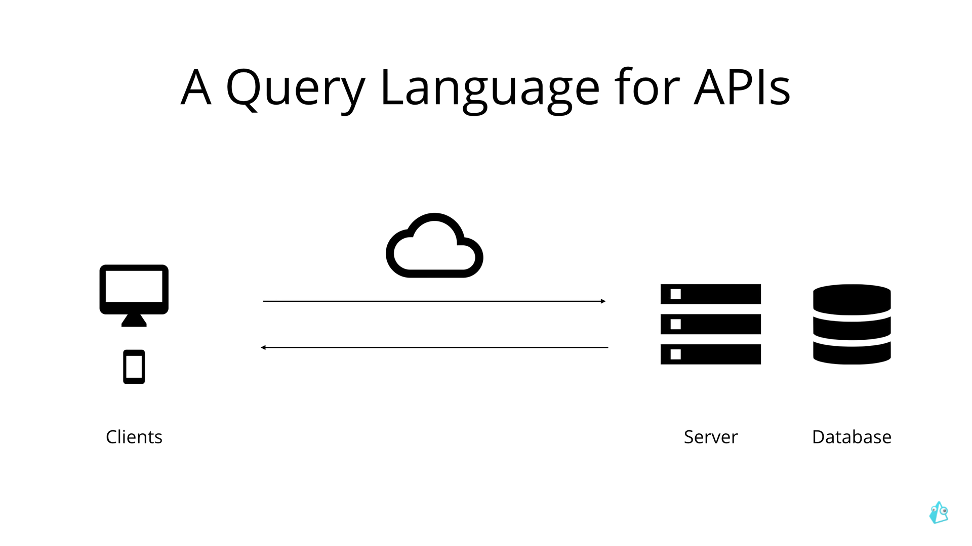

Slide 4
Features
1. Strongly Typed
GraphQL uses a schema to define data types.
Ensures data sent and received is valid and predictable.
2. Single Endpoints
Unlike REST APIs, GraphQL uses a single endpoint.
Clients can send queries or mutations to specify data needs.
3. Hierarchical Queries
Queries are hierarchical, allowing clients to specify data structure.
Retrieve only required data, reducing over-fetching or under-fetching.

Slide 5
Features
4. Mutations
GraphQL supports mutations for modifying data on the server.
Create, update, or delete resources through mutation requests.
5. Subscriptions
GraphQL supports real-time updates through subscriptions.
Clients can subscribe to specific events or changes.
6. Resolvers
Resolvers fetch requested data from various sources.
Determine how to resolve each field in a GraphQL query.

Slide 6
Benefits
1. Efficient Data Fetching:
Clients retrieve exactly the data they need, reducing network overhead.
2. Flexible and Evolvable APIs:
Clients can request new fields without backend changes.
Enables versioning and gradual adoption.

Slide 7
Conclusion
GraphQL offers a more efficient and flexible approach to API development.
Strongly typed, hierarchical queries, resolvers, mutations, and subscriptions are key features.
Popular implementations include Apollo Server, GraphQL-JS
Benefits include efficient data fetching and evolvable APIs.

Slide 8
References
https://www.howtographql.com/basics/0-introduction/
https://www.youtube.com/watch?v=_raXT2TiDz0
Spring Boot With Graph QL Code:
https://github.com/FinlaAndrew/GraphQl

